Slide 1
Economics Project
Group 13

Slide 2
Group Members
Raj Shah – 1401050
Kashish Shah – 1401048
Akash Soni – 1401047
Deval Shah – 1401060
Abhishek Chaudhary-1401059
Maharshi Bhavsar – 1401061
Jeet Parekh – 1401011
Deep Parekh – 1401001
Malav Vora - 1401062

Slide 3
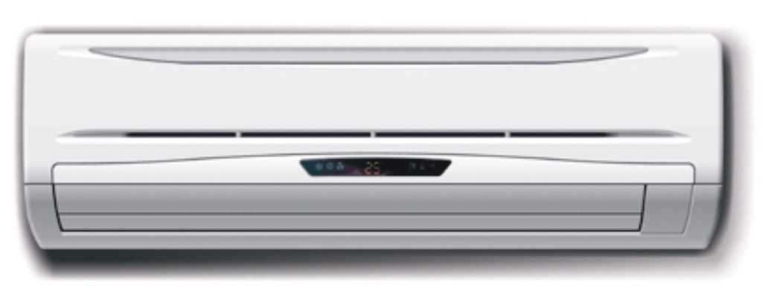
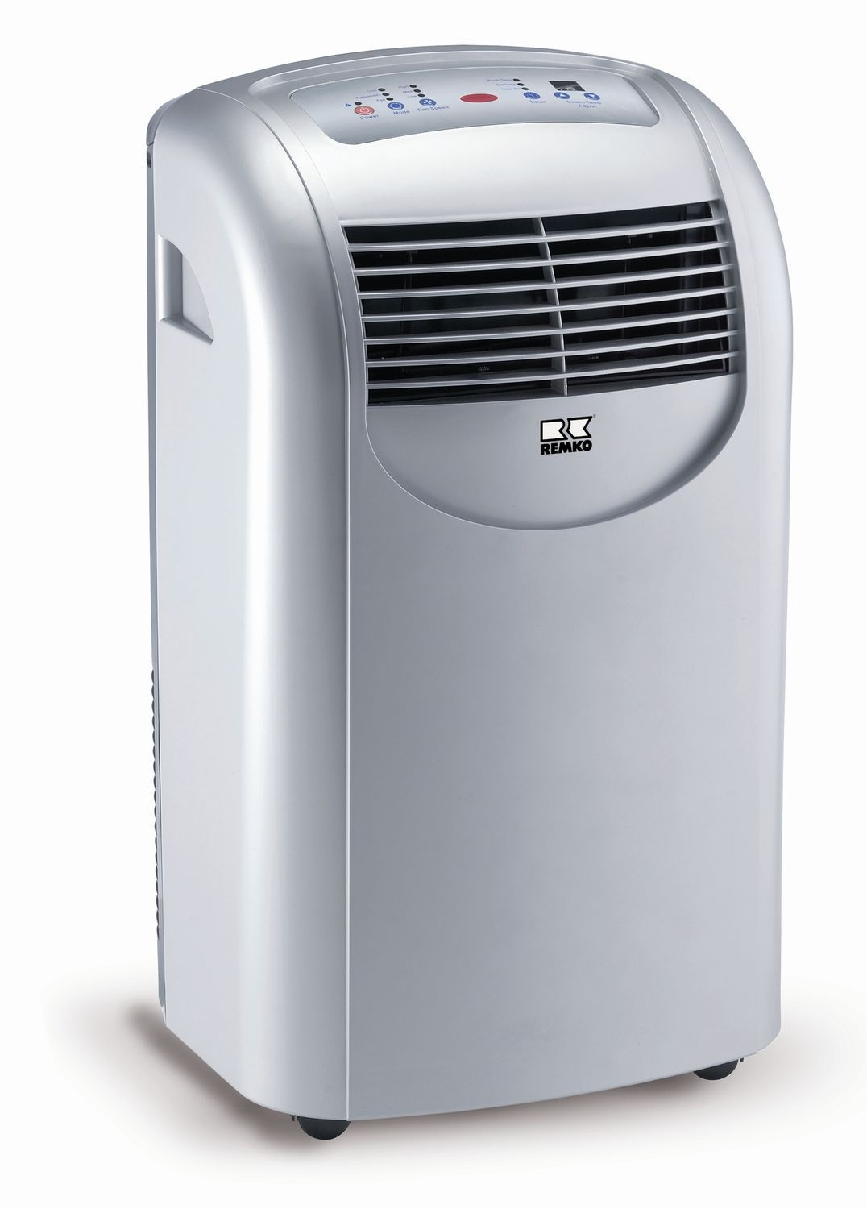
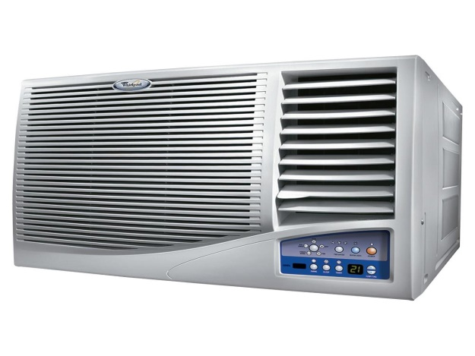
Air Conditioner

Slide 4
Classification of A/Cs
Windows AC
Cassette AC
Tower AC
Split AC
Ductable AC
Package AC

Slide 5
Types of AC
Commercial
VRF system(Variable Refrigerant flow system).
Household
1)Natural Air cooling System (Conventional).
2) Chiller System.

Slide 6
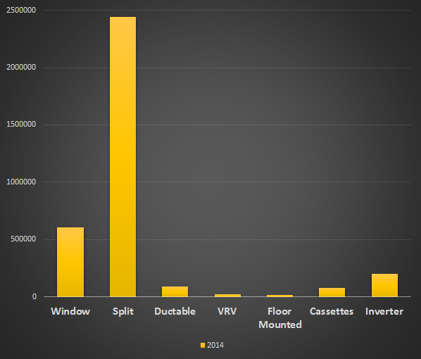
AC Market Share

Slide 7
Overall Market Growth
Consumer Annual Growth Rate (CAGR) has been 18 – 20% over last decade.
Market grew from 3.8 million in 2013-14 to 4 million in 2014-15.
The Split AC’s are the highest selling ACs compared to the other types.
The market of split AC’s is focused in report ahead.

Slide 8
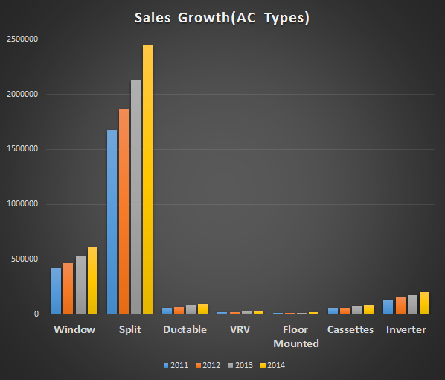

Slide 9
Trend Of AC Brands
In financial year 2014-2015 , the leading brands in AC market are LG , Voltas ,Hitachi, Daikin and Carrier in INDIA.
Highest market share belongs to LG for SPLIT AC’s in India.
Other brands that are gradually increasing competitions are MICROTEK etc.

Slide 10
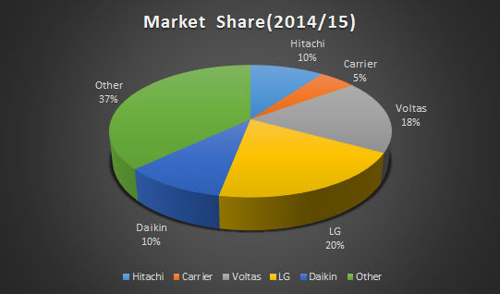

Slide 11
Energy Efficient Ratio (EER - Watt/Watt)
It is one of the important standard set by BE.
In order to meet the evolving technology and the increasing Energy Efficient Ratio the medium and Indian standard companies launch new models every year which have the improved technology.
Whereas the Electronic giants on the other hand, launch such products that they are capable of staying in the market for a fairly longer time period amongst all the technology improvements.
The technology of these products is so reliable that its EER is of the level as required even years after.

Slide 12
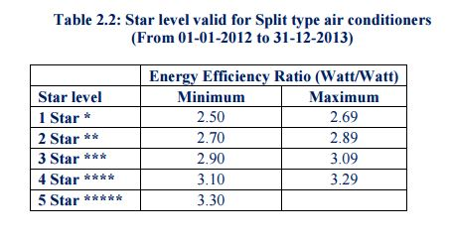
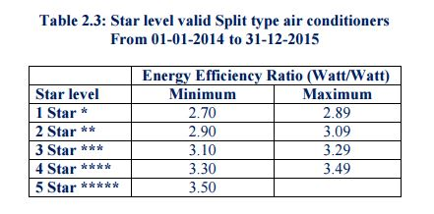
Star Ratings for Split AC’s

Slide 13
Factors Affecting The Demand
Positive Factors
Environmental reasons.
Increasing average temperatures.
Increasing humidity.
Increase in disposal income(total income – taxes).
Negative Factors
Power shortage.
Poor quality of power.
Increase in excise duty.

Slide 14
Mean Temperature Change In Last Decade
Temp(Celsius)
Year

Slide 15
Other Factors
Urbanization
Increased population and urbanization has made ACs a necessity rather than just a product since last few years.
Advance in technology.
Advanced technology like sensible cooling, mosquito away technology, etc.
Increase in retail stores and online shopping.
Exporting of ACs from China.
With the involvement of China in AC production and exporting it at a very low cost, many local AC brands come up in the market.

Slide 16
Other Factors
Emission of CFC
Due to increased emission of CFC, new models having highly advanced technology with reduced CFC emission are launched with a levelled EER which results in price rise of new models of ACs.

Slide 17
Demand
Due to the above mentioned factors, the demand has been increased ever since.
Demand of AC’s has risen due to increased innovation over past decade leading to :
reduction in size
energy efficient
multi functionality etc.
Trend of demand curve shows how sales in past five years have increased due to above factors.

Slide 18
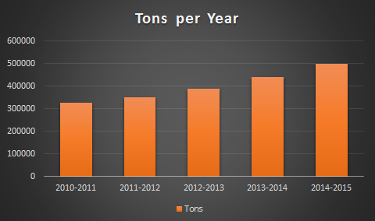
Demand Trend

Slide 19
Supply Trend
The increase of approx. 3-4 % is noted every year in sales considering total market of split AC’s in India.
Supply has notably increased in past years due to huge market demand and so has the prices
Price Increase has not affected the demand much due to reasonable range of product line in different brands.

Slide 20
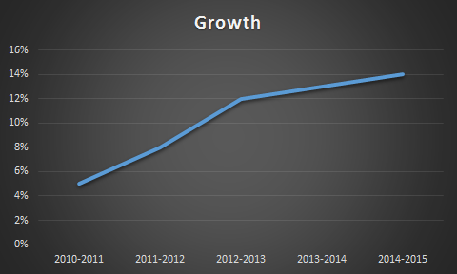
Supply Trend

Slide 21
Brand Wise Elasticity Trends
Different brands have different elasticity ratios
(change in qty/change in price).
The fluctuation in elasticity in every year decides
whether the brand is stable in market or not.
All the brands below shows elasticity ratio > 1
So we can say that supply is elastic for all.
Carrier brand shows max elasticity supply ratio in last year.

Slide 22
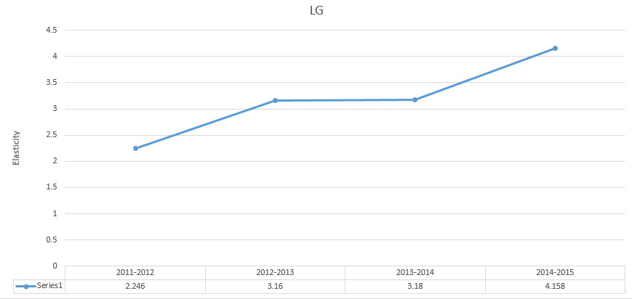
LG Elasticity Trend

Slide 23
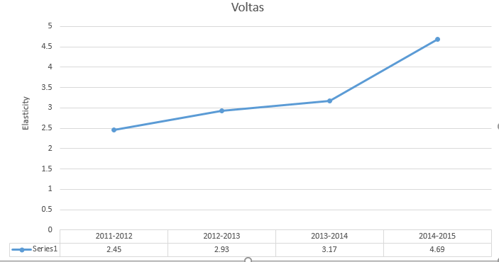
Voltas Elasticity Trend

Slide 24
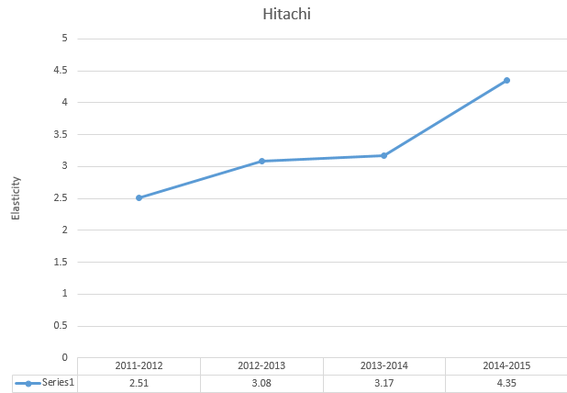
Hitachi Elasticity Trend

Slide 25
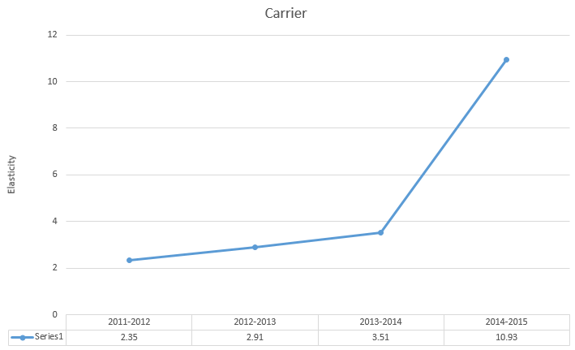
Carrier Elasticity Trend

Slide 26
Comparison Of Price vs Quantity Between Different Brands
Different leading brands basis on their market share, no of customers and demand for their product in market have different fluctuations in terms of price and quantity.
Price vs Quantity trends are very important to visualize as it gives an idea on what could be the factor that could increase demand of their product in market in future.

Slide 27
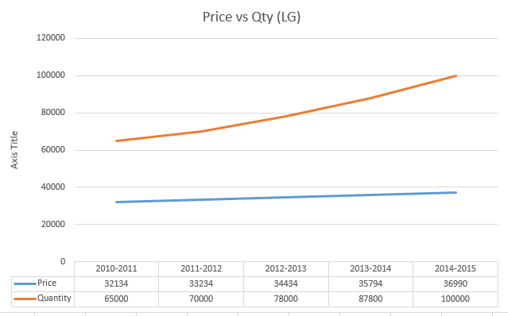
Price vs Qty-LG

Slide 28
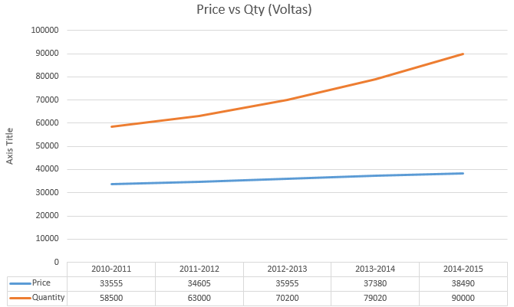
Price vs Qty-Voltas

Slide 29
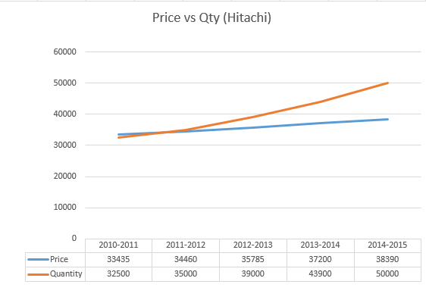
Price vs Qty-Hitachi

Slide 30
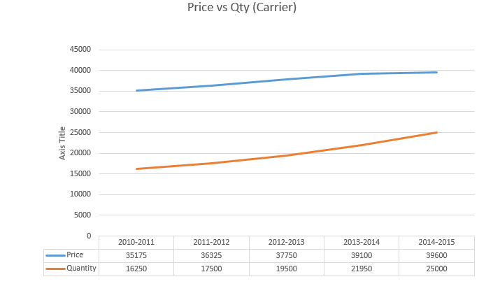
Price Vs Qty-Carrier

Slide 31
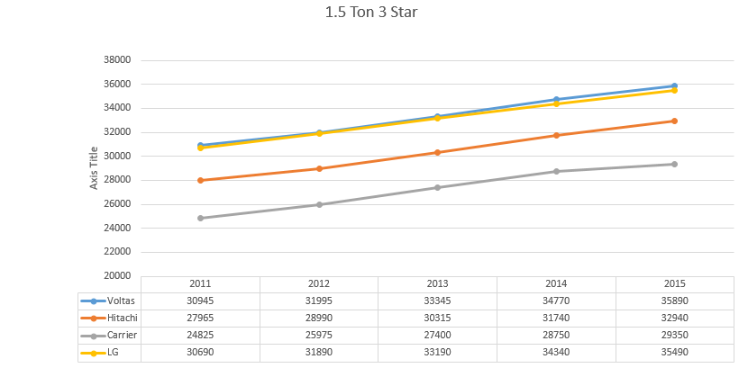
Price Trends For Different Brands

Slide 32
Resources
Aditi Enterprise
--Price List of AC Brands
--ISHRAE(Indian Society of Heating, Refrigerating & Air-conditioning Engineers) Market Research Paper
-- Sales Reports of past years.
Modern Economic Theory – BY K.K .Dewwet
Internet

Slide 33
Thanks!!

